Slide 1
Presentations for Diverse Learners
Designed by Aneta Mandarino

Slide 2
Key Focus Points
Terminology:
Universal Design (UD)
Universal Design for Learning (UDL)
Universal Design for Instruction (UDI)
What are the similarities between UD, UDL, and UDI?
What are the differences between UD, UDL, and UDI?
2

Slide 3
Universal Design
Definition
“The design of products and environments to be usable to the greatest extent possible by people of all ages and abilities”.
What are UD principles?
Equitable use.
Flexibility in use.
Simple and intuitive use.
Perceptible information.
Tolerance for error.
Low physical effort.
Size and space for approach and use.
3

Slide 4
Universal Design for Learning Definition (UDL)
“Universal Design for Learning (UDL) is a framework for addressing the educational needs of diverse and variable learners in many settings across many stages of life. It is a means to eradicate persistent inequities in education, informed by the educators who use it and their students”. (Mnicholis, 2023)

Slide 5
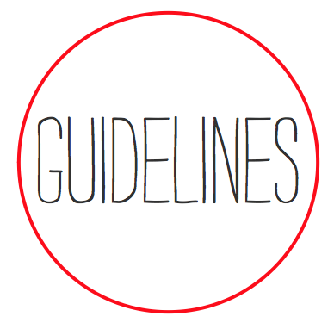
Universal Design for Learning Principles (UDL)
Engagement
Recruiting Interest
Sustaining Effort & Persistence
Representation
Perception
Language & Symbols
Comprehension
Action & Expression
Physical Action
Expression & Communication
Executive Function
5

Slide 6
Universal Design for Instruction (UDI)
Universal Design for Instruction UDI means that, rather than designing for the average student, you design instruction for potential students who have broad ranges with respect to ability, disability, age, reading level, learning style, native language, race, and ethnicity. (Burgsthaler)
What is the UDI process?
Describe the course, learning objectives, and content.
Consider the diverse characteristics of potential students.
Integrate UDI with evidence-based teaching practices
Plan for accommodations.
Evaluate.

Slide 7
UDI Best Practices
Class Climate
Welcome everyone.
Avoid stereotyping.
Be approachable and available.
Motivate all students.
Address individual needs.
Create a syllabus with contact information and resources.
Interaction
Offer multiple options for communication.
Encourage inclusive and cooperative learning.
Physical Environment & Products
Ensure physical access to facilities.
Arrange instructional spaces to maximize inclusion and comfort.
Ensure all learners can use equipment and materials.
Safety.

Slide 8
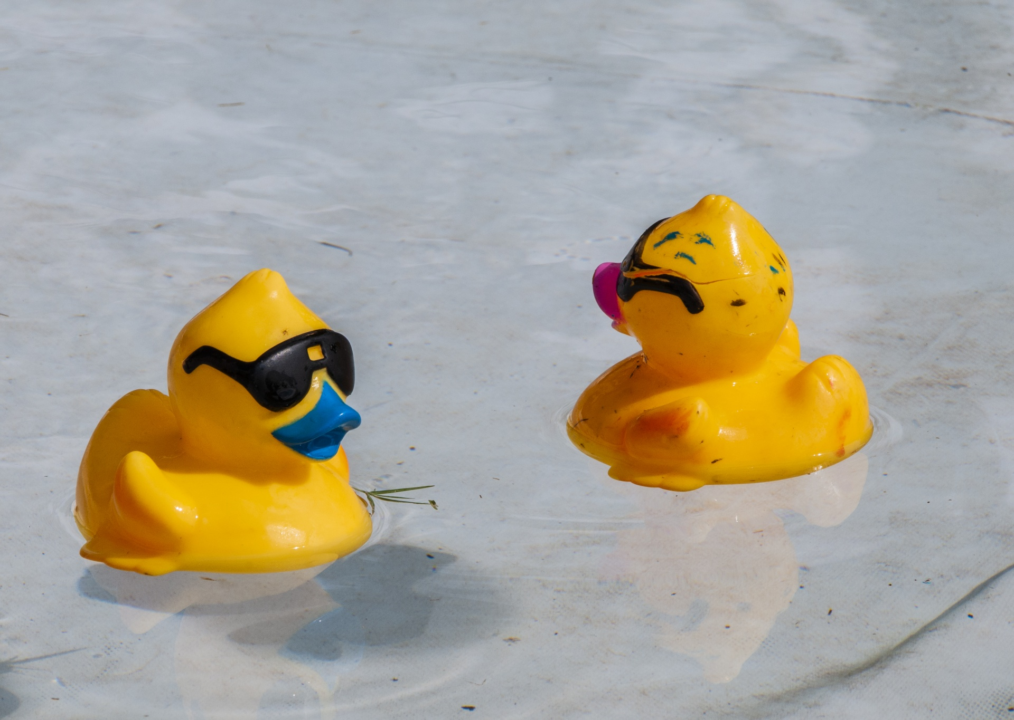
UDI Best Practices Continued
Delivery Methods
Create relevant content.
Select a flexible schedule.
Provide cognitive support.
Offer multiple ways to learn.
Write clear instructions.
Use large visual aids.
Make each teaching method accessible to all.

Slide 9
UDI Practices
Feedback & Assessment
Set clear expectations.
Test in the same way you teach.
Offer timely and constructive feedback.
Offer multiple ways for learners to demonstrate what they learned.
Monitor and adjust.
Provide sample test questions, exemplary work or study guides.
Accommodations
Plan for accommodations.
Share accommodation information

Slide 10
Similarities between UD, UDL, and UDI
Focus on Accessibility and Inclusivity.
Emphasis on Flexibility and Customization based on diverse needs of learners.
Recognition of Diversity - a fundamental similarity among UD, UDL, and UDI is the recognition of diversity among individuals.

Slide 11
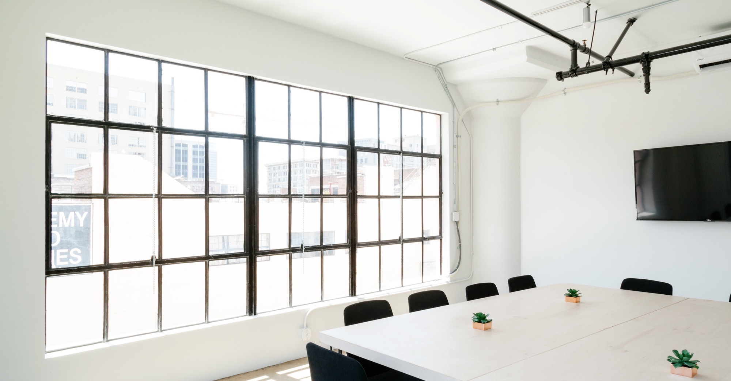
Differences between UD, UDL, and UDI: Scope and Application
UD applies across various domains, including architecture, product design, and urban planning.
UDL specifically addresses the design of instructional materials, methods, and assessments to accommodate the diverse needs of learners.
UDI focuses specifically on instructional practices and strategies employed by educators to create inclusive learning environments.

Slide 12
Differences between UD, UDL, and UDI: Target audience
UD is typically applied to the design of physical spaces, products, and systems, ensuring accessibility for all.
UDL targets educators and instructional designers, equipping them with guidelines and strategies to create inclusive learning for diverse learners.
UDI is aimed at educators and instructional leaders, guiding and adjusting instructional practices to accommodate diverse learner needs and foster equitable access to education.
This Photo by Unknown Author is licensed under CC BY

Slide 13
Questions?
13

Slide 14
Thank You
Aneta Mandarino
+949 357 4330
amandarino@sandiego.edu
14

Slide 15
References
Burgsthaler, S. (n.d.). Equal access: Universal design of instruction. https://www.washington.edu/doit/sites/default/files/atoms/files/EA_Instruction_5_28_20_0.pdf
Falcone, K. (2024). Module 3 Introduction. In University of San Diego. https://sandiego.instructure.com/courses/5981/pages/module-3-overview?module_item_id=420505
Mnicholis. (2023, December 7). UDL-con: International. Universal Design for Learning Implementation and Research Network. https://udl-irn.org/udl-con-international/
15

